Slide 1
Major Project - I Presentation
Design and Development of Learning Management System
Developed By:
Akhil Tiwari
Priyanshu Dubey

Slide 2
HACKHIVE
WHAT ?
HACKHIVE is a web based learning management system/ platform which can be used to evaluate the student’s learning. This platform is developed in modular approach. It has different modules for different works and different accessibility levels. It is focused on online learning delivery and support a range of uses.
WHY ?
It is very important platform which can help faculties to deliver materials to students and other assignments, Track student progress, and manage record-keeping, handles online course administration, and tracking, and assessment of students work. It is also very useful in identifying progress towards learning and trainings. Supports Online Learning from anywhere and anytime. It helps in sharing up the student skills.

Slide 3
HackHive
STUDENT MODULE
TEACHER’S MODULE
PHASE-1
Modules
ADMIN MODULE
ADMIN WITH BIRD EYE
QUIZ APP
PROGRAMMING ARENA

Slide 4
STUDENT MODULE
Student module is added with very limited access reach. They can only work on the contents that are provided to them by admin or by teachers.
These are few features of student module:
Create account (No Approval Required By Admin, Can Login After Signup)
After Login, can see how many courses/exam & questions are there in system on dashboard.
Can give exam any time, there is no limit on number of attempt.
Can view marks of each attempt of each exam.
Question pattern is MCQ with 4 options and 1 correct answer.

Slide 5
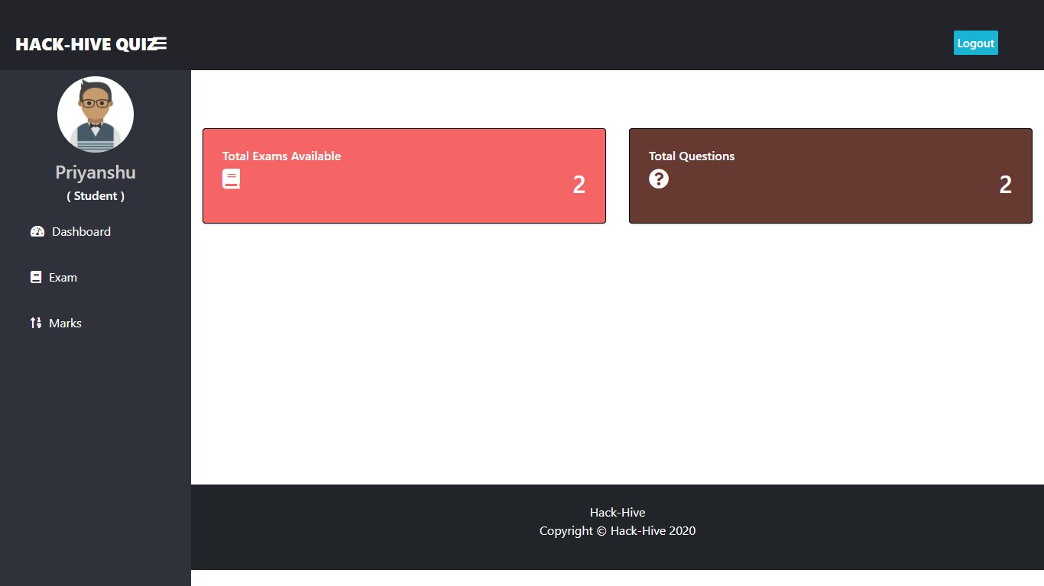
STUDENT MODULE

Slide 6
TEACHER’S MODULE
Teacher’s have some extra features from students, but they also don’t have all the accessibility.
These are few features of teacher’s module:
First they have to register themselves. Then Login (Approval required by system admin, Then only teacher can login).
After Login, can see Total Number Of Student, Course, Questions are there in system on Dashboard.
Can Add, View, Delete Course/Exams.
Can Add Questions To Respective Courses With Options, Correct Answer, And Marks.
Can View And Delete Questions Too.

Slide 7
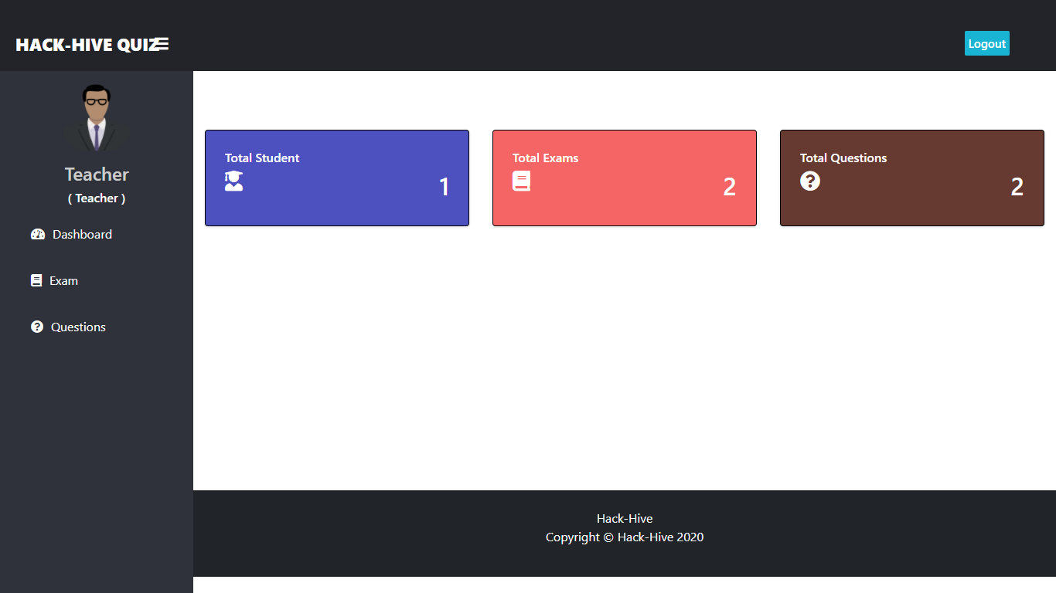
TEACHER’S MODULE

Slide 8
ADMINISTRATOR
In this project, we have given the bird eye to the Administrator, they can manage both teacher and students, and also Quiz/Exams.
These are few features of admin module:
Create Admin account using command
py manage.py createsuperuser
After Login, can see Total Number Of Student, Teacher, Course, Questions are there in system on Dashboard.
Can View, Update, Delete, Approve Teacher.
Can View, Update, Delete Student.
Can Also See Student Marks.
Can Add, View, Delete Course/Exams.
Can Add Questions To Respective Courses With Options, Correct Answer, And Marks.
Can View And Delete Questions Too.

Slide 9
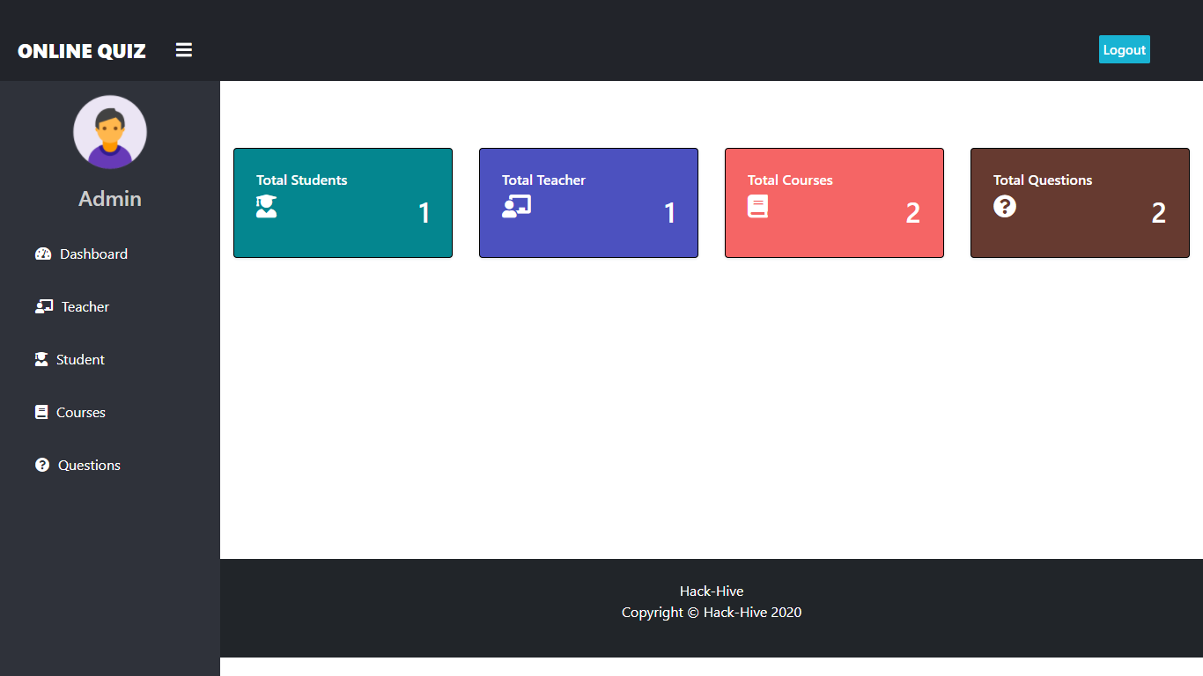
ADMINISTRATOR

Slide 10
Programming Arena
Programming Arena Module is being built for programming practices and conduct programming challenges.
Programs can be written in a special editor embedded on the console it self.
The editor has theme and brackets corrector, and colouring theme based on word entered into it.
The standard compilers are used and modular approach will help in extending the same.
Currently support three languages c, c++ and python.

Slide 11
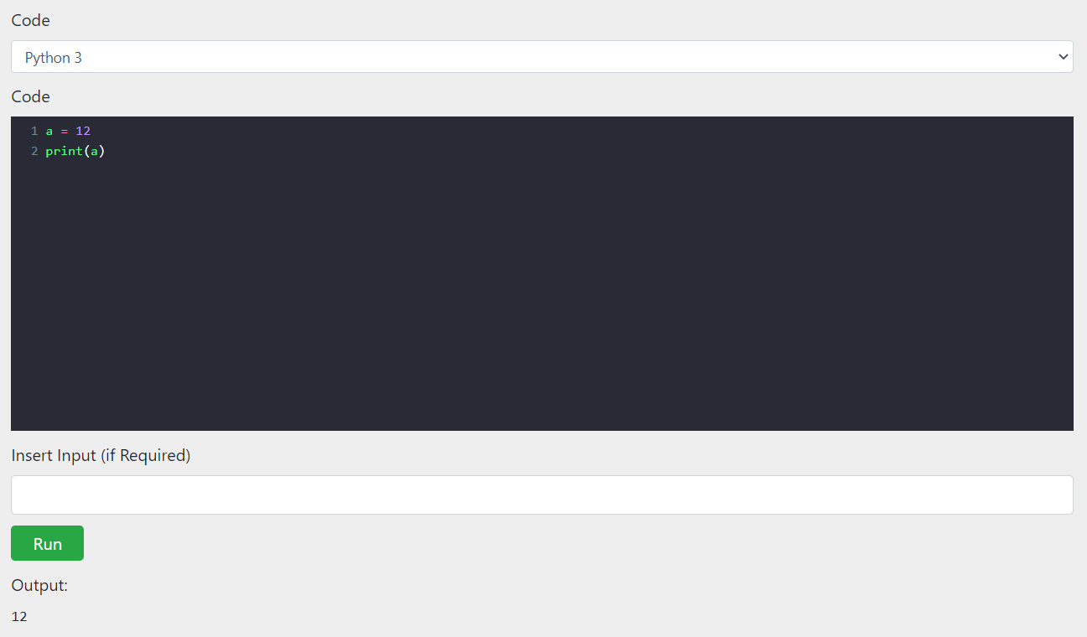
Programming Arena

Slide 12
Thank You

